Slide 1

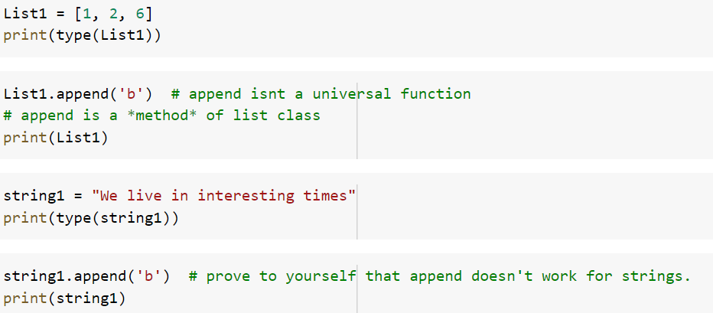
Intro to Classes & Objects
Everything in python is an object.
Objects in python belong to classes.
Classes can be thought of as stict patterns or templates that define both the structure and behavior of an object in python.

Slide 2
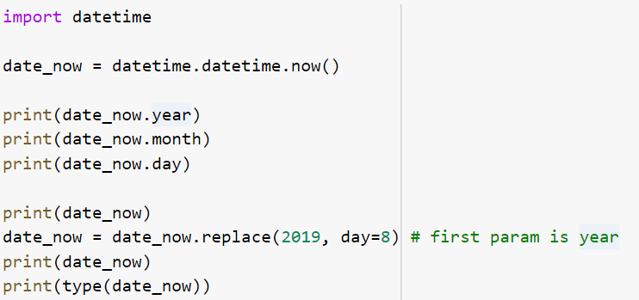
Another example
Lets look at another more specialized class that comes in one of the core Python libraries
date_now is an object of datetime
year, month, and day are attributes (or variables) of datetype class
replace()is a method or built-in function of datetime

Slide 3

Why object-oriented programming?

Slide 4
Why object-oriented programming?

Slide 5
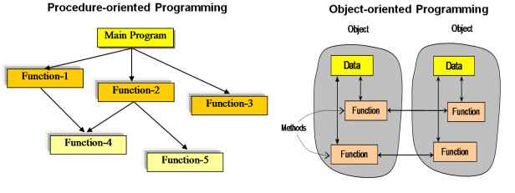
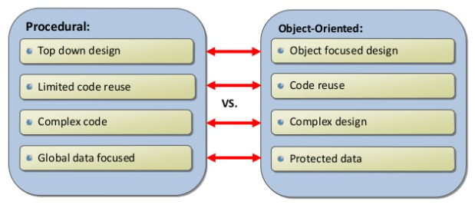
Advantages of object-oriented programming
https://www.c-sharpcorner.com/UploadFile/8a67c0/oops-vs-procedural-programming/
Haris Bin Zahid 2015

Slide 6
Classes
Python starts to get powerful when we make our own classes.
A class is a blueprint for a type of object that lays out the kinds of attributes and methods that are availble to it.
Using classes makes code more readable.
It also makes it easier to code!
Think of classes as a template or blueprint. the class is not what is doing things - the objects of the class - thats what is actually doing work - in your case processing data.

Slide 7
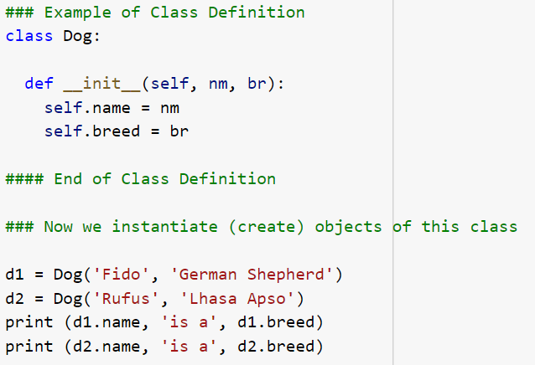
Classes - Example
we've created two objects d1 and d2 of the dog class.
these objects have different data but they have the same structure.

Slide 8

Defining Classes
The class keyword is followed by the name of the class
Classes are capitalized and CamelCase
Class body is indented
Just like a function
All classes have at least 1 method called a constructor
Constructers use __init__() which is called a “dunder init”
__init__() is used to create an object of the class
The constructor accepts arguments
The first argument is always self
self refers to the current instance
Other arguments are for attributes
Often classes have additional methods that give functionality

Slide 9
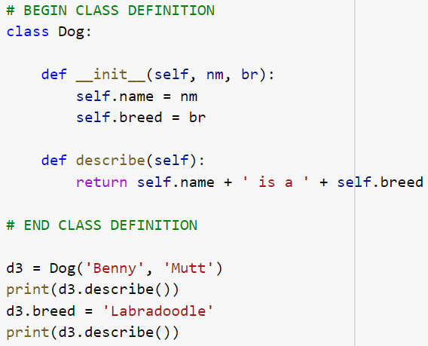

Class Methods - Example
Now we’ve added a method.
Predict what it does before trying it out.
Annotate the code for your understanding

Slide 10
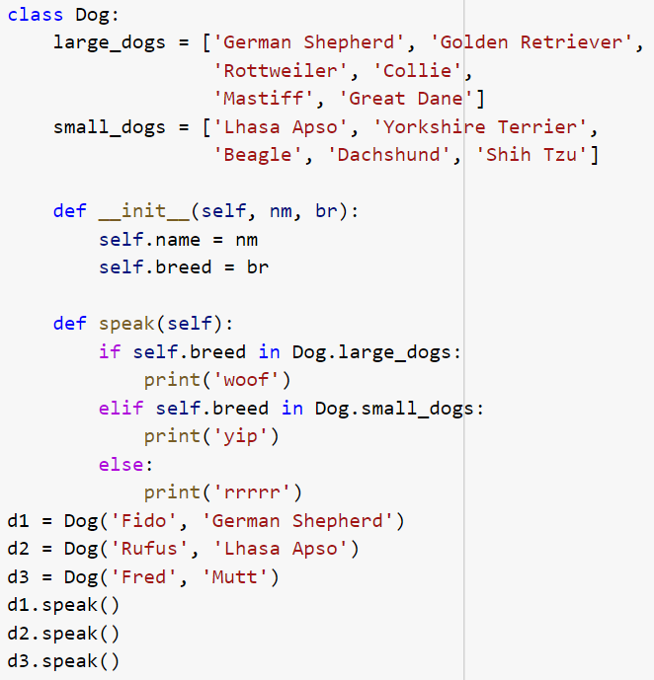
Class vs Instance Attributes
an intricacy that may trip you up is demonstrated here.
Use in-code commenting to document it.

Slide 11
Class vs Instance Attributes
Large dogs, small dogs
This is an example that involves class attributes rather than instance attributes.
small_dogs and large_dogs belong to the whole class and all instances can access them. whereas instance attributes are only attached to self
Two key points:
unlike instance attributes, class attributes can be defined outside of any method
to reference class attributes use the class name (Dog) rather then self
Class attributes are used for defining constants or other data that can't be changed and must be accessible to all.

Slide 12
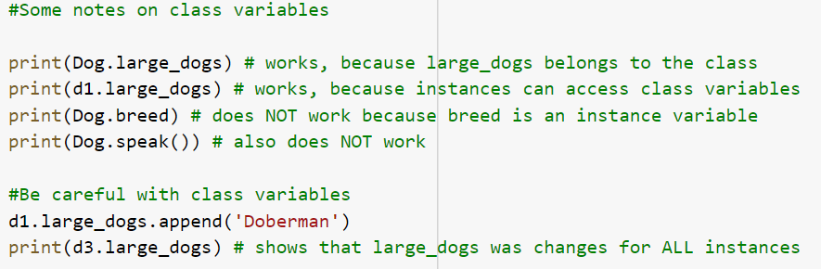


Class Variables

Slide 13
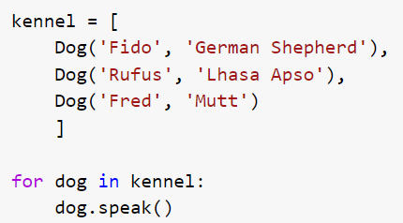
Class Streamline Code
The for loop in this code looks simple - but it shows how powerful classes can be.
You can write code that manipulates complex objects (usually more complex than our Dog) in a uniform way.

Slide 14
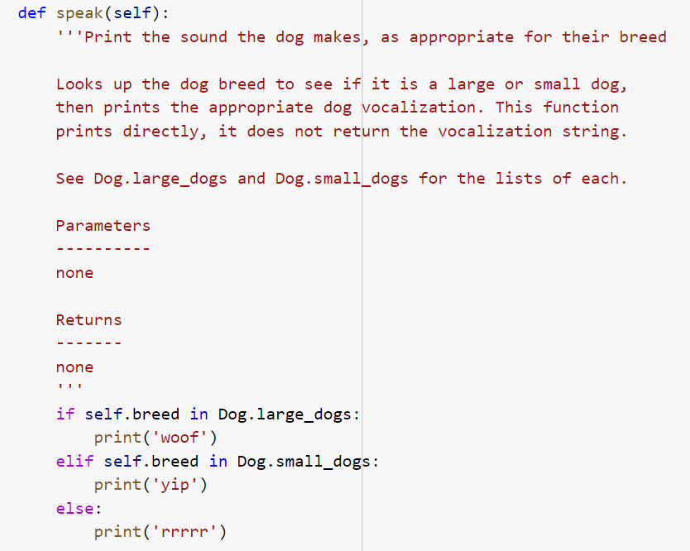
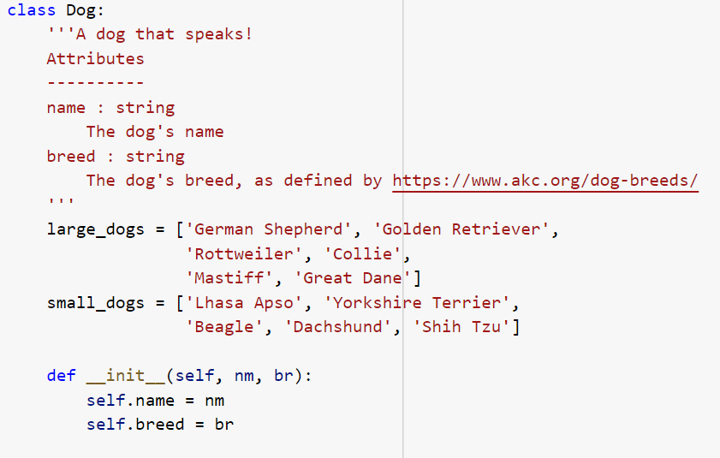
Classes have Docstrings
Classes have a lot of structure and functionality that is not immediately apparent - therefore we need docstrings
Both the attributes and each method have a docstring
The method docstring is similar to functions

Slide 15
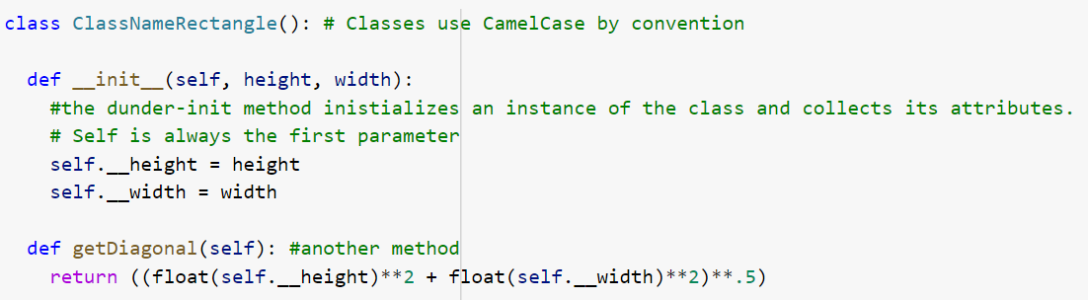


Classes, Subclasses & Inheritance
Let’s reinforce the format of classes
And let’s practice instantiating an object of a class

Slide 16
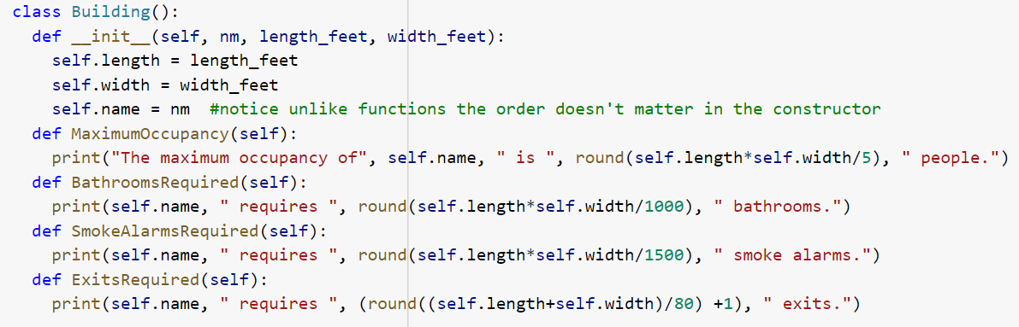
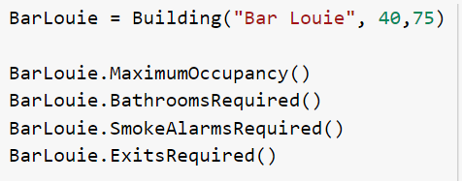
Example 1
So now lets work with a more meaningful example.
Imagine you had a python program that was used to calculate several building regulations in a straight-forward way based on the size of the building.
What do you think this does
Take a minute to think through how it works
Here’s an instance of the Building class

Slide 17
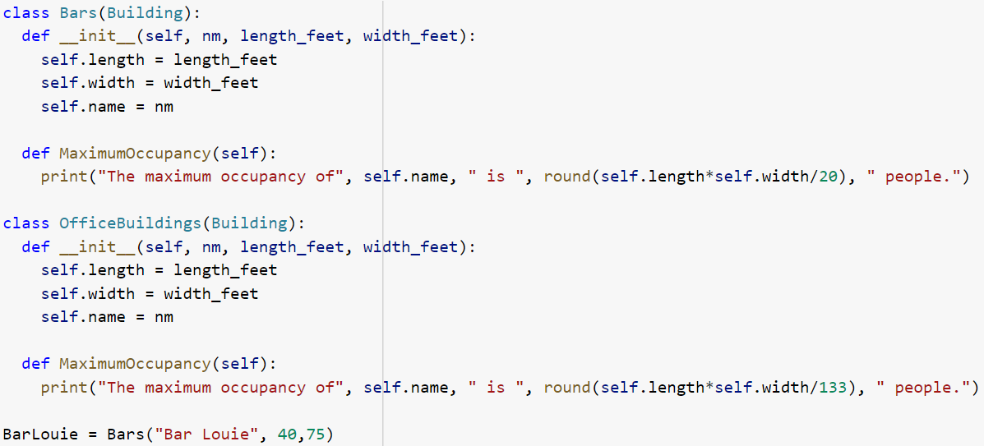

Subclass Example
Imagine that there is a situation in which there is an uncontrolled respiratory virus.
In this circumstance you may need to adjust the maximum occupancy of different buildings based on the prevalence of the virus, the ventilation of the building, and the reliance of that business on in-person services.
You wouldn't need to change the other parts of the building regulations
Instead of remaking the clases, you can just make what is called a subclass
Lets take a look at the example below.
The parent class, in this case Building, is located within the parentheses of the subclass

Slide 18
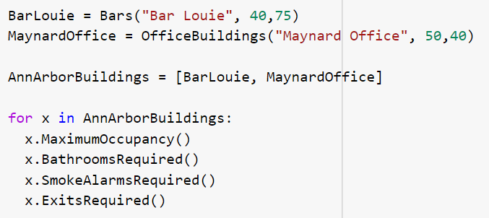
Subclass Example
Bars and OfficeBuildings are subclasses of Buildings
Buildings are the superclass of Bars and OfficeBuildings.
You can think of subclasses and superclasses as "child" and "parent" classes.
The relationship is defined in the class defintion.
class Bars(Buildings):
Bars and OfficeBuildings overide the __init__() method.
They also override the instance attribute self.name, self.length, self.width
Bars & OfficeBuildings override the MaximumOccupancy() method from Buildings, and inherit ExitsRequired(), SmokeAlarmsRequired(), and BathroomsRequired().
By default subclasses automatically inherit methods and attributes of a superclass unless they override them.

Slide 19
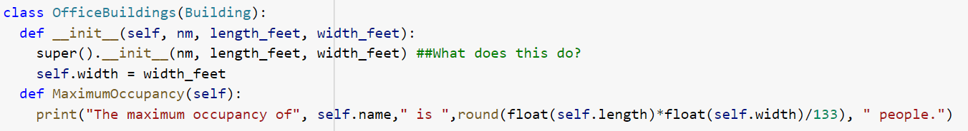
Inheritance details
By default subclasses automatically inherit methods and attributes of a superclass unless they override them.
the line super().__init__(nm). super() is a special function that, when used inside a class definition, returns the superclass.
So super().__init__(nm) is how you call the constructor of the superclass.
Useful if the superclass has a lot of stuff
super().method() can also be used to invoke a superclass method

Slide 20
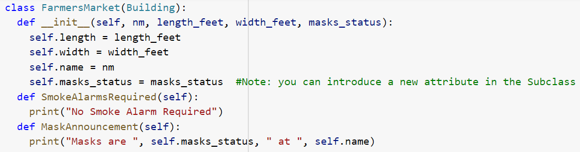
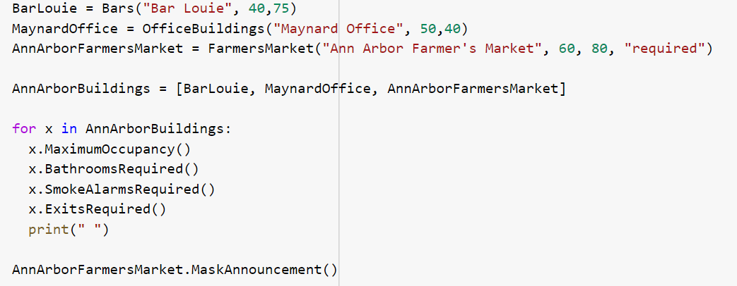
More Inheritance details
Predict the output
Annotate to your understanding

Slide 21
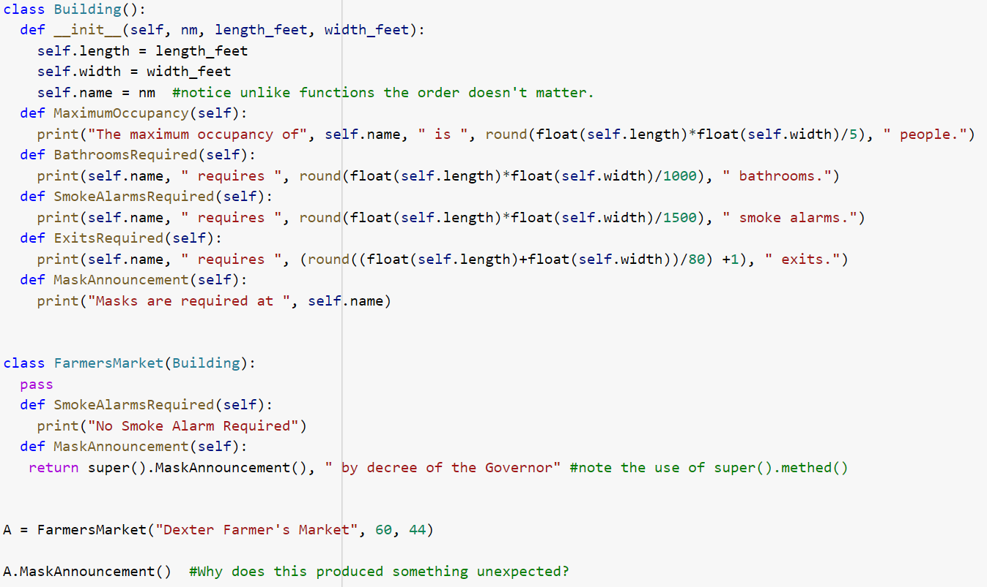
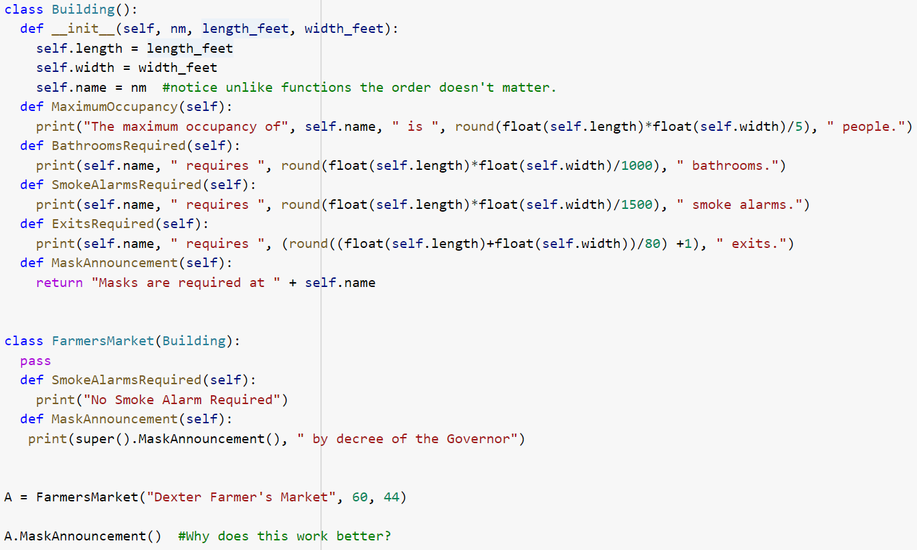
The most specific attribute/method takes precedence
Why does the example on the right work better?
Hint look at the use of print and return in the subclass and superclass methods for MaskAnnouncement()
Annotate to your understanding

Slide 22
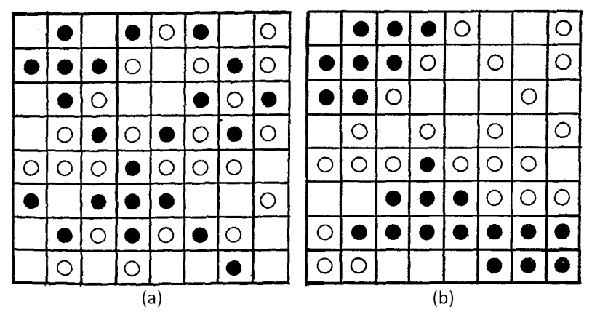
Schelling Simulation of Segregation
Deeply flawed examination of how much individual preference is required for systemic segregation
Pseudocode
Agents:
type (purple or gold)
Location
Happiness
Methods:
determine whether happy or not given locations of other agent
If not happy, move
Repeat until happy

